Slide 1
Lesson 1 Chapters 1-2
Install Java
Run your first program
Install Eclipse

Slide 2
Install Java
Run the installer
Two parts installed; JRE, and JDK.
Verify installation
Check the PATH environment variable
Run Java -version from command-line

Slide 3
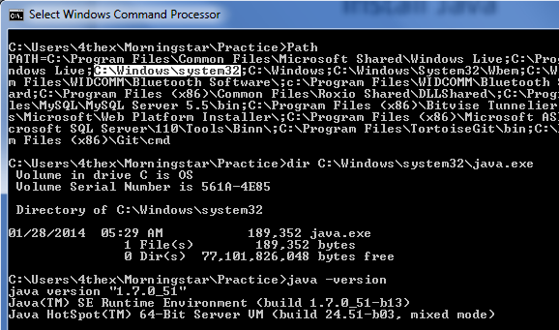
Install Java - verify

Slide 4
Run your first program – the source code
Type the following into Notepad:
class HelloWorld {
public static void main(String[] args) {
System.out.println("Hello World");
}
}
Save as HelloWorld.java

Slide 5
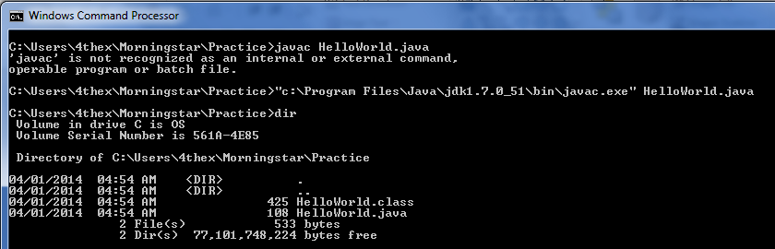
Run your first program - compile it
In a command shell type:
C:\practice\> "{JDK-path}\bin\javac.exe" HelloWorld.java
The {JDK-path} is where you installed the JDK.

Slide 6
Run your first program - compile it
Cafe Babe!
… in grepping for 4 character hex words that fit after "CAFE" (it seemed to be a good theme) I hit on BABE and decided to use it. At that time, it didn't seem terribly important or destined to go anywhere but the trash-can of history. So CAFEBABE became the class file format.
James Gosling (The father of the Java Programming Language)

Slide 7
Hexadecimal Number System
Base is 16 instead of 10 as in the decimal number system.
16 different digits 0-9, A-F
2 Hex digits = 1 byte = 8 bits
Bits are the digits in the binary number system the consists of only 0, and 1.
Example 26_{dec} = 1A_{hex} = 00011010_{bin}

Slide 8
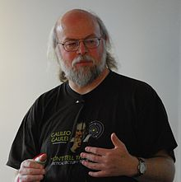
Java Programming Language
Java 1.0 released 1995.
Java 8 released March 2014.
Thoughts for students
About 9M programmers
James Gosling
Similar to C, C++, C#, PHP
Java is classical, JavaScript is prototypical
Other prototypical languages are Ruby, and Python

Slide 9

Run your first program - run it

Slide 10
Install Eclipse
Simply extract and run eclipse.exe

Slide 11
Eclipse
Let’s do the same thing in Eclipse.

Slide 12
A closer look
class HelloWorld {
public static void main(String[] args) {
System.out.println("Hello World");
}
}
Notes:
Every java source file must have a class (or interface – we’ll learn about that later). It must be named the same as the file.
The main class or the first class to be run by the JVM must have a static method that returns void (meaning nothing) named main with one String-array argument. The argument will contain extra arguments on the java.exe command-line.
The System.out refers to a static field in the System class named out which is a PrintStream. The method println will output it’s argument(s) to the console.
Of course we have to nicely close the scope. Scope is defined with curly braces.

